Slide 1
Digital-to-Analog (DAC) and Analog-to-Digital (ADC) Converter
There are two basic type of converters:
Digital-to-analog (DACs or D/As)
Analog-to digital (ADCs or A/Ds).
In the case of DACs, they output an analog voltage that is a proportion of a reference voltage, the proportion based on the digital word applied.
In the case of the ADC, a digital representation of the analog voltage that is applied to the ADCs input is outputted, the representation proportional to a reference voltage.

Slide 2
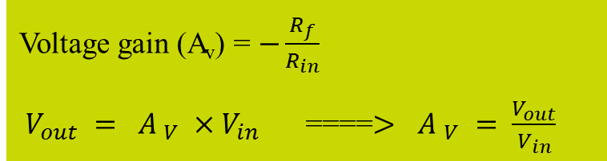
The Major factor in the DAC circuit is the operational amplifier which is characterized by high input impedance, low input impedance and a variable voltage gain that can be set with external resisters.
Voltage gain (A_{v}) = $−\frac{R_{f}}{R_{in}}$
${ V_{out} = {A }_{V} ×V}_{in}$ ====$>$ ${A }_{V} = \frac{V_{out}}{V_{in}}$

Slide 3
Digital-to-Analog (DAC)
General DAC Characteristics:
There are six key parameters you should consider when choosing a DAC.
A. Reference Voltage B. Resolution C. Linearity D. Speed E. Settling Time F. Error
A. Reference Voltage
To a large extent, the characteristics of a DAC are defined by its reference voltage.
Non-multiplier DAC: V_{Ref} is fixed (specified by the manufacturer)
Multiplier DAC: V_{Ref} is provided via an external source
B. Resolution
Resolution is a measure of precision, not accuracy. It is defined as the voltage change corresponding to changing the LSB.
Many options in the 8-16 bit range, with 12 bits being a typical cost / resolution trade off.
More bits More steps Greater Resolution
Resolution = V_{LSB} = V_{Ref} / 2^{N}
- Where N is the number of bits

Slide 4
C. Linearity
Ideally, a DAC will produce a linear relationship between a binary word and analog output
D. Speed
Usually specified as conversion or sampling rate.
High speed DACs are typically defined as >1MS/s (1 MHz)
Some current 12-16 bit DACs can reach the 1GHz range
Conversion of input signal is limited by
Clock speed of the input signal
Settling time of the DAC
E. Settling Time
Ideally, an immediate change in analog voltage would occur when a new binary word enters into a DAC.
Settling time is the time taken by the DAC to reach ½ of the LSB of its new voltage.
Components include delay, slew time, and ring time.
Fast converters reduce slew time, but usually result in longer ring times.
Delay time is normally a small term.

Slide 5
F. Errors
Because we do not live in an “ideal” world, considerations for possible error should be made.
Non-Linearity: Occurs when analog output of signal is non-linear
Differential – analog step-sizes changes with increasing digital input (measure of largest deviation; between successive bits
Integral – amount of deviation from a straight line after offset and gain errors removed; on concurrent bits
Non Monotonicity: Occurs when an increase in digital input results in a decrease in the analog output
Offset Error: Occurs when there is a constant offset between the actual output and the ideal Output
Gain Error: Occurs when the slope of the actual output deviates from the ideal output
Resolution error: Poor representations of ideal output due to poor resolution Size of voltage divisions affect the resolution

Slide 6
Digital-to-Analog Conversion Methods
Types of DAC Circuits:
1. Resistor-string
2. N-Bit Binary Weighted Resistor
3. R-2R Ladder

Slide 7
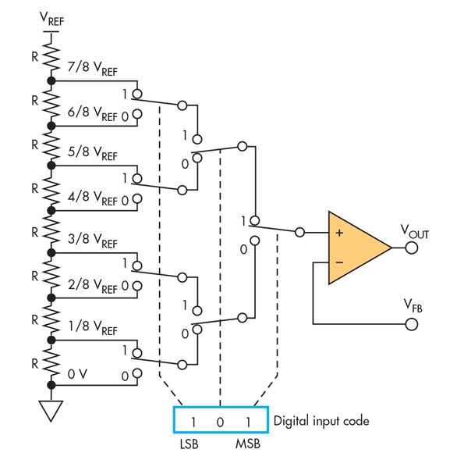
Resistor-string DAC
Example of 3 bit resistor-string DAC
Required component
- a resistor string
- a set of switches – select output to use
- Operational amplifier – buffer
Example:
How many resistors and switches would be required to implement an 8 bit resistor-string DAC?
Sol:
# of resistors = 2^{N}=2⁸=256
# of switches =
Impractical for converters with more than a few bits of resolution

Slide 8
Advantages and Disadvantages of R-string DAC:
• Advantages:
– Simple, fast for < 8-10 bits
– Inherently monotonic
– Compatible with purely digital technologies
• Disadvantages:
– 2^{B} resistors and 2^{B} switches for B bits à High element
count & larger area for B>10bits
– High settling time for B > 10.

Slide 9
Binary-weighted-input DAC
The binary-weighted-input DAC is a basic DAC in which the input current in each resistor is proportional to the column weight in the binary numbering system. It requires very accurate resistors and identical HIGH level voltages for accuracy.
LSB
8R
D₀
R_{f}
The MSB is represented by the largest current, so it has the smallest resistor. To simplify analysis, assume all current goes through R_{f} and none into the op-amp.
4R
D₁
2R
V_{out}
D₂
Analog output
D₃
R
MSB

Slide 10
Binary-weighted-input DAC
Example
A certain binary-weighted-input DAC has a binary input of 1101. If a HIGH = +3.0 V and a LOW = 0 V, what is V_{out}?
120 kΩ
R_{f}
+3.0 V
60 kΩ
10 kΩ
0 V
30 kΩ
V_{out}
+3.0 V
15 kΩ
+3.0 V
Solution
V_{out} = I_{out} R_{f} = (−0.325 mA)(10 kΩ) =
−3.25 V

Slide 11
R-2R ladder DAC
R-2R ladder:
The R-2R ladder requires only two values of resistors. By calculating a Thevenin equivalent circuit for each input, you can show that the output is proportional to the binary weight of inputs that are HIGH.
Each input that is HIGH contributes to the output:
where V_{S} = input HIGH level voltage
n = number of bits
i = bit number
Inputs
D₀
D₁
D₂
D₃
For accuracy, the resistors must be precise ratios, which is easily done in integrated circuits.
R₁
R₃
R₅
R₇
R_{f} = 2R
2R
2R
2R
2R
R₂
R₄
R₆
R₈
2R
R
R
R
V_{out}

Slide 12
R-2R ladder DAC
Example
An R-2R ladder has a binary input of 1011. If a HIGH = +5.0 V and a LOW = 0 V, what is V_{out}?
D₀
D₁
D₂
D₃
+5.0 V
+5.0 V
0 V
+5.0 V
R₁
R₃
R₅
R₇
R_{f} = 50 kΩ
50 kΩ
50 kΩ
50 kΩ
50 kΩ
R₂
R₄
R₆
R₈
50 kΩ
25 kΩ
25 kΩ
25 kΩ
V_{out}
Solution
Apply to all inputs that are HIGH, then sum the results.
Applying superposition, V_{out} =
−3.43 V

